Slide 1

Stage 7
Tape Is Expensive
Course Designer: Eric Beerbaum
Tape Is Expensive is a 16 round, 80 point Comstock long course. There are 14 USPSA targets and 2 steel targets. The best one hit per target will score. Steel must fall to score. The start signal is audible
The Handgun start position is anywhere outside shooting area, handgun loaded and holstered, wrists below belt.
The PCC start position is anywhere outside shooting area, PCC loaded, stock on belt, muzzle generally downrange.
On the audible start signal, engage all targets from within the shooting areas.
Notes:
‹#›

Slide 2
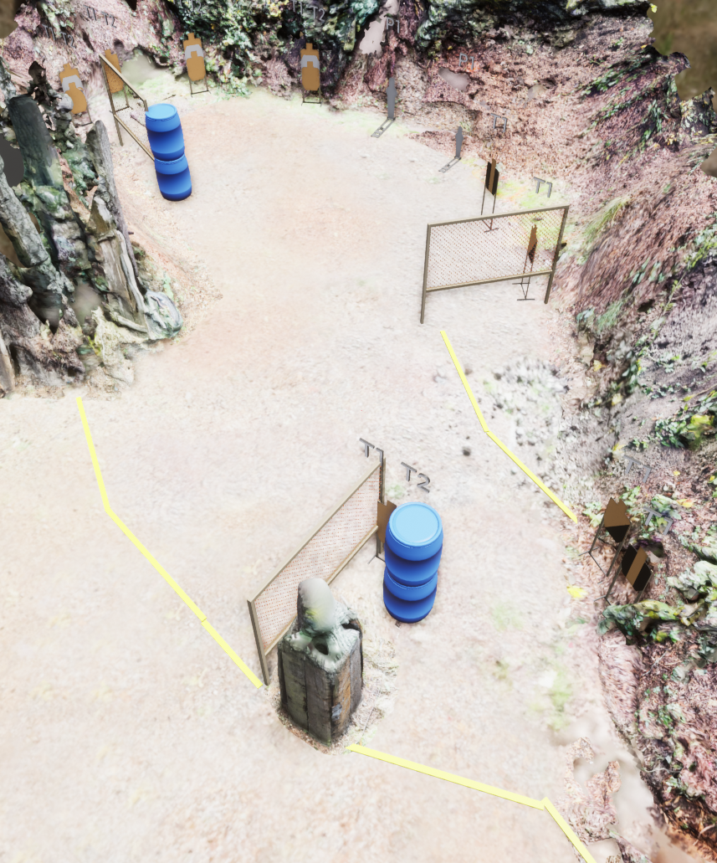
 | Stage 7 Tape Is Expensive Course Designer: Eric Beerbaum
Shooting Area 2
Shooting Area 1

